Slide 1

MOVIE DATA EDA
By Kishore Ohal

Slide 2
MOVIE DATA EDA
The Movie data set contains top rank 1000 movies from year 2006 to 2016.
The movie data set has 12 columns namely Actors, Description, Director, Genre, Metascore, Rank, Rating, Revenue (Millions), Runtime (Minutes), Title, Votes and Year.

Slide 3
Packages and Library
Numpy and Pandas library available in python are used Analyze the data
The NumPy library is the core library for scientific computing in Python. It provides a high - performance multi-dimensional array , and tools for working with these arrays.
The Pandas library is built on NumPy and provides easy-to-use data structures and data analysis tools for the Python programming language.
Used seaborn and matplotlib packages
This packages are used to give visual representation to user about the data.

Slide 4
Pre Profiling
Profiling helps us understanding the data set
To gain insights from data I looked into each aspect of it very carefully.
I start with observing few rows and columns of data both from the starting till the end
I observed that data has 12 Columns and 1000 rows.

Slide 5
Columns in Dataset
Rank - Movie rank order
Title - The title of the film
Genre - A comma-separated list of genres used to classify the film
Description - Brief one-sentence movie summary
Director - The name of the film's director
Actors -A comma-separated list of the main stars of the film
Year - The year that the film released as an integer.
Runtime (Minutes) - The duration of the film in minutes.
Rating - User rating for the movie 0-10
Votes - Number of votes
Revenue (Millions) - Movie revenue in millions
Metascore - An aggregated average of critic scores. Values are between 0 and 100. Higher scores represent positive reviews.

Slide 6
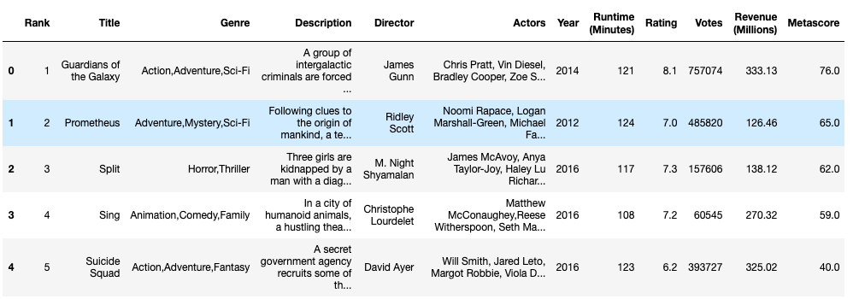
Sample Data Set

Slide 7
Pre Profiling Findings
1. The Revenue and Metascore column count is less than other columns. we will check this column to check whether it has any NULL values.
2. The Min value of Year is 2006 and Max value is 2016.
which suggest that this data is between year 2006 and 2016
3. We can also see there are 207 Genre but we will be concentrating on most used.
4. We can see Genre column has values which are combination of different genre.

Slide 8
Data Clean Up
We have replaced Revenue and Metascore with mean value

Slide 9
Data Post Profiling
I also did Post profiling and observe the data behavior.
It makes data clean without Null values

Slide 10
Questions
We will be checking the behavior of each column on revenue generation
We will also be checking the behavior between few columns

Slide 11
Ridley Scott directed most movies total 8.

Slide 12
2016 saw sudden rise in revenue compare to year 2015.
overall there was steady revenue increased between 2007 and 2014.

Slide 13
2016 saw almost more than twice number of movies released compare to year 2015.
overall there was steady number of movies released between 2007 and 2014 like within 50 to 100 range.

Slide 17
We have seen Drama and Action Genre were released more followed by comedy.

Slide 18
We have seen western and War Genre were released less.

Slide 19
Revenue and Votes are highly corelated
Rating and Metascore are highly corelated
Rating and votes are somewhat corelated
Rank and Year has no effect whatsoever on Revenue generation, nor votes, nor metascore

Slide 20
Conclusion
The Data set was pretty clean.
Ridley Scott directed most movies total 8.
2016 saw almost more than twice number of movies released compare to year 2015.
overall there was steady number of movies released between 2007 and 2014 like within 50 to 100 range.
As we can see, Rating doesn't matter much when it comes to revenue generation. As we can see rating between 6 to 8 more or less have same revenue.
Revenue is less when the ratings are below 5.
We observe, having a rating of 9 didn't earn much revenue
We have seen Drama and Action Genre were released more followed by comedy.
Revenue and Votes are highly corelated.
Rating and Metascore are highly corelated.
Rating and votes are somewhat corelated.
Rank and Year has no effect whatsoever on Revenue generation, nor votes, nor metascore.

Slide 21
Thank You

